Slide 1
TOPIC 1:
INTRODUCTION TO REFERENCE AND INFORMATION SERVICES
IMD312/307:
REFERENCE AND INFORMATION SERVICES FOR INFORMATION AGENCIES

Slide 2
TOPIC 1:
1.1 Definition
1.2 Varieties of Reference Services
1.3 Types of Reference Functions
1.4 History of Information Services
1.5 Electronic Reference Services

Slide 3
DEFINITION
Information services in libraries take a varieties of form including direct personal assistance, directories, signs, exchange of information culled from reference source, reader’s advisory service, dissemination of information in anticipation of users need or interest and access to electronic information.
(American Library Association - The Reference and User Services Association)

Slide 4
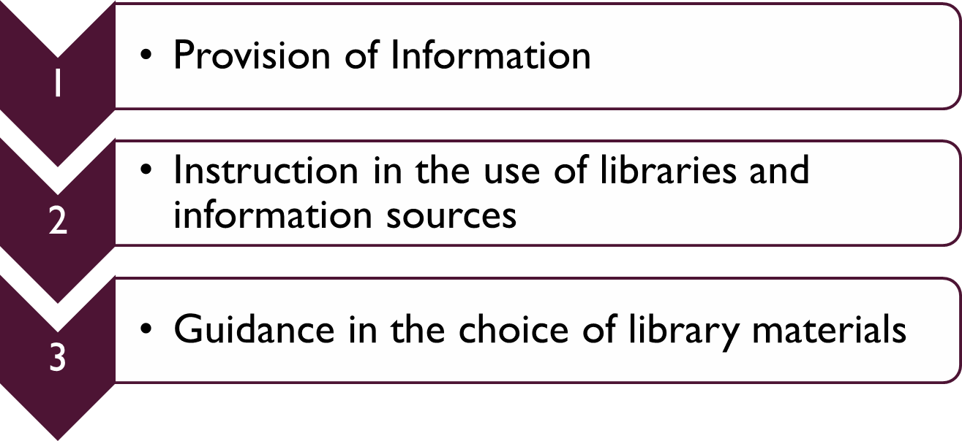
VARIETIES OF REFERENCE SERVICES
Rothstein

Slide 5
1. PROVISION OF INFORMATION

Slide 6
INFORMATION SERVICES
Provide answer to a user’s question or information need regardless of its complexity or the length of time it takes the librarian to find the answer.
Variety of forms.

Slide 7
FORMS OF INFORMATION SERVICES
Answer Ready Reference Questions
Bibliographic Verification
Interlibrary Loan (ILL) & Document Delivery Services (DDS)
Information & Referral Services
Answer Research Questions
Database Searches
Fee-based & Information Brokering

Slide 8
ANSWER READY REFERENCE QUESTIONS
Definition:
A question that can be answered quickly by consulting to only one or two reference tools
Request for factual information or brief information
Constitute majority of questions received at most reference desks in public and academic libraries

Slide 9
BIBLIOGRAPHIC VERIFICATION
Provides facts about publications
Requires librarian to search the printed or electronic versions of standard bibliographic tools to verify that the user’s information about a document is correct and complete
Involves using what information is available to the librarian to find the missing information

Slide 10
INTER LIBRARY LOAN & DOCUMENT DELIVERY SERVICE
ILL - process by which a borrower in one library obtains the use of books, periodical or other library materials from another library
DDS - service that supplements ILL. Involves purchasing information sources from commercial document suppliers when access from other libraries is either unavailable or too slow

Slide 11
INFORMATION & REFERRAL SERVICES
Usually in public libraries
Goal: “facilitating the link between a person with a need and the resource or resources outside the library which can meet the need” (Childers, Thomas)
  Outside resources may include social service agencies, community organizations, government offices, or individuals

Slide 12
INFORMATION & REFERRAL SERVICES
2 basic types of I &R services:
a) those that only provide information about agencies – (provide agency name, address & telephone number to user along with some information about the agency

Slide 13
INFORMATION & REFERRAL SERVICES
b) those that provide information and make direct referrals to agencies – librarian contact the agency to verify that it can and will assist the individual; this process will require much more time and effort in organizing material, training staff and coordinating service with local agencies

Slide 14
ANSWER RESEARCH QUESTIONS
Require considerable time and effort from the librarian
User’s information need is broader and/or the question asked more complex or less concretely defined
Librarian must carefully review the question with the user to ensure the question is completely understood by both parties
Several sources may need to be checked before complete answer is found

Slide 15
FEE-BASED & INFORMATION BROKERING
Found both in public and academic libraries
Serve information need of business, professionals and other users for fee
Extraordinary service includes extensive database searching, document delivery, compiling bibliographies, expert consultation and other services

Slide 16
2. INSTRUCTIONAL SERVICES

Slide 17
AIMS OF USER EDUCATION PROGRAM
to provide information on the library's services and holdings
to familiarize users with the physical layout of the library
to create an awareness of specialized library services

Slide 18
AIMS OF USER EDUCATION PROGRAM… CONT’D
to provide long term user education in the form of modules which can teach library skills, such as how best to conduct a literature search
to create a positive attitude among users towards the library and its staff
**Central to these aims is the belief that knowing how to find information is as important as the information found.

Slide 19
TYPES OF USER EDUCATION PROGRAM
Library Orientation
Library Instruction
Bibliographic Instruction
Information Management Education / Information Literacy Skills

Slide 20
LIBRARY ORIENTATION
Service activities designed to welcome and introduce users and potential users to services, collections, building layouts, and the organization of materials
Methods:
Guided tour through the reference room | Interactive Media Technology
Handouts | Microcomputers software
Guides | Video Productions
Multi-Media Programme | Electronic Bulletin Board
Self-guided Audio Tours

Slide 21
LIBRARY INSTRUCTION
a major component of reference service in academic & school libraries and an important aspect of reference work in most public libraries, and it can be found in varying degrees in different kinds of special libraries
one to one / group instruction
three (3) frequent forms
- teaching how to use library effectively
- suggesting specific strategies to be used in locating and
evaluating information
- instructing in the use of specific information sources, both
printed and electronic

Slide 22
LIBRARY INSTRUCTION…CONT’D
refers to instruction in the use of libraries with an emphasis on institution specific procedures, collections and policies
focusing on in-depth explanation of library materials,
concentrates on tools and mechanics, including techniques in using periodical indexes, reference sources, card and online catalogues and bibliographies

Slide 23
LIBRARY INSTRUCTION…CONT’D
Methods:
Lectures
Discussions
Workbooks
Media Presentations
Computer Assisted Instructions
Handouts

Slide 24
BIBLIOGRAPHIC INSTRUCTION
Instructional programs designed to teach library users how to locate the information they need quickly and effectively.
BI usually covers the library's system of organizing materials, the structure of the literature of the field, research methodologies appropriate to the discipline, and specific resources and finding tools (catalogs, indexes and abstracting services, bibliographic databases, etc.).

Slide 25
BIBLIOGRAPHIC INSTRUCTION
In academic libraries, bibliographic instruction is usually course-related or course-integrated. Libraries that have a computer-equipped instruction lab are in a position to include hands-on practice in the use of online catalogs, bibliographic databases, and Internet resources. Instruction sessions are usually taught by an instructional services librarian with specialized training and experience in pedagogical methods. (ODLIS)
activities that are designed to locate and use information
goes beyond the physical boundaries of the library and beyond institution specific confines

Slide 26
BIBLIOGRAPHIC INSTRUCTION…CONT’D
Methods:
Methods :
Media production | Lectures
Computer Assisted Instructions | Small Group Work
Demonstrations | Discussions
Self-guided Workbook | Simulations

Slide 27
INFORMATION MANAGEMENT EDUCATION / INFORMATION LITERACY INSTRUCTION
instructing users in the identification, retrieval, evaluation and use of information

Slide 28
METHODS TO CARRY OUT INSTRUCTIONAL SERVICES
Informal
□ One-on-one instruction or point- of-use instruction
□ Quite detailed and the most effective instruction, but occurs "on demand“

Slide 29
METHODS TO CARRY OUT INSTRUCTIONAL SERVICES…CONT’D
Formal
a) Tours and Orientation
b) Classroom Presentations
Course-integrated Instruction:
One-Shot Lectures or
"the fifty-minute stand".

Slide 30
METHODS TO CARRY OUT INSTRUCTION SERVICES …CONT’D
c) Collaborative (two-way) Learning
d) Tutorials
* Also known as consultation service. In academic libraries, the consultation
focuses on scholarly projects

Slide 31
GUIDANCE SERVICES

Slide 32
3. GUIDANCE SERVICES
Similar to instruction but somehow different focus;
Give advices and assist user in the identification and selection of appropriate materials about a particular topic, rather than teaching specific skills
4 types of services…

Slide 33
READER’S ADVISORY SERVICES
helping readers choose the books best suited to their interest, needs and reading levels
interviewed library users to understand their needs and goals, and then choose library materials to full-fill those needs and goals - reading list
sometimes use current awareness services and library use instruction to assist readers in using the library and keeping aware of new books in their fields of interest

Slide 34
BIBLIOTHERAPHY
Biblio-therapists use literature, film, or other media chosen for their appropriateness to the needs of the group
to assist the personal growth or rehabilitation of group members through discussion of the material read or viewed
2 types :
a) clinical - encourage self understanding
b) developmental - promote self knowledge,
personal growth

Slide 35
TERM PAPER COUNSELING
Sometimes called term-paper assistance or research consultation
Widespread in academic libraries
Term paper clinics, which consist of group instruction in library use and research skills,
May be offered in addition to or instead of the individual assistance provided in term paper counselling sessions

Slide 36
SELECTIVE DISSEMINATION OF INFORMATION (SDI)
Interest profile is matched against newly published or received information sources, or indexes to them, on some periodic basis (usually through the use of computer) and the user is notified of the result
Librarian can deliver to the user the citations of materials

Slide 37
HISTORY OF INFORMATION SERVICES
Reference service had its origin in the second half of the 19th century, partially in response to the spread of education, in which was considered to be the most importance accomplishments during the era.

Slide 38
EARLY HISTORY
Modern concept of the reference work were traced way back to Samuel Green’s paper, ‘Personal relations between librarians and Readers’ published in American Library Journal (now Library Journal)
The three basic reference function were also include in Green’s paper – information, guidance and instruction

Slide 39
EARLY HISTORY
Green advices:
Librarian should find information and present it to the users
Instruction in the use of encyclopaedias and indexes to books
Invitation to ask for assistance if the needed information is not readily found
Guidance in the choice of recreational reading materials or in the conduct of research into the specific topics
Librarian should be friendly and give effective assistance to the users

Slide 40
TWENTIETH CENTURY
During the first half of the century, the concepts and practices of reference work expanded
Specialized services such as readers advisory service and biblio-theraphy were developed
Public library reference department began answering requests by phone, offering reference services in branch libraries

Slide 41
TWENTIETH CENTURY
Reference services experienced dramatic changes - increasingly became more efficient and effective
From face-to-face interaction; reference service by telephone, mailed or referred questions from users who had no direct contact with the library
Academic librarians teach and answer students’ questions in classrooms, provision of reference service by fax and e-mail is expanding

Slide 42
TWENTIETH CENTURY
Some libraries have eliminated their reference desk, replaced with tiered system that offers ready-reference service at an information desk and in-depth reference services in the offices of reference librarians

Slide 43
PRESENT CENTURY
Development of local electronic community information network enhances the growth of state, regional and local library consortia and systems
Creation of electronic cataloguing utilities made it easier to locate needed sources in other libraries
Useful for bibliographic verifications questions
Internet provided librarians with new options in the search of information needed by users

Slide 44
PRESENT DAY
Cooperative reference services not restricted to the library’s collection alone but librarian can tap information resources in other libraries through out the state or across the entire Internet

Slide 45
ELECTRONIC REFERENCE SERVICES
Libraries include the information professions also facing the electronic age and have experienced transformation.
Revolutionized access to information in libraries of all kinds and sizes
Catalogs enable users to access vast amount of information available through the Internet

Slide 46
ELECTRONIC REFERENCE SERVICES
History of electronic resources for reference services began with the development of computer-assisted typesetting and printing.
The publishers of indexing and abstracting services first used computers to print their paper products. They created magnetic tapes that were interpreted by a computer and drove their printers.
Computers could also read these magnetic tapes for other purpose.

Slide 47
ELECTRONIC REFERENCE SERVICES
Companies and government agencies in the US (e. g. : National Library of Medicine) developed computer software that could read and manipulate the information on these magnetic tapes in new ways.
This software allowed reference librarians in those organizations to ask the computer to ‘search’ for an indexed term or group of terms to see if there were bibliographic citations to articles on these tapes that would meet the information needs of their users.

Slide 48
ELECTRONIC REFERENCE SERVICES
These single-agency search systems formed the foundation of the information retrieval industry in the 1960s.
Search systems that had been developed for use within a single corporation, such as Lockheed’s Dialog and System Development Corporation’s ORBIT, were expanded in their scope to serve the research needs of other major research institutions such as universities, government agencies and other large corporation.

Slide 49
ELECTRONIC REFERENCE SERVICES
Modems allowed remote access to huge computers rather than limiting access to hardwired terminals.
Magnetic tape was replaced by much faster disk tracks – provide the first truly online searching (the searcher and the search systems communicating interactively)

Slide 50
ELECTRONIC REFERENCE SERVICES
Academic libraries began offering email reference services in the late 1980’s [according to ListServe discussions & journal literature dating back to 1986].
Generally they became prevalent in the early 1990’s
Many services began an Ask A Librarian Services – remain the most common name used for these services.

Slide 51
ELECTRONIC REFERENCE SERVICES
More libraries receive and answer reference questions via e-mail and other ways as mean to serve remote users (e.g. Facebook, Twitter, etc…)
Impacts on every facet of the reference librarian’s work
Vast increase in the number and types of information sources that are readily available.

Slide 52
Thank You

